Slide 1
Drone Conversion Appliances (DCA)
Date: 31 March 2023
DCA Team
Project Advisor: Dr. Yongcan Cao, ECE
Team Sponsor: USL Lab, UTSA
Team Members: Ehab Afsoonko, Conrad Obeng, Lexi McMinn, Mark James Jr., Matthew Moubray
“Expanding the world of Modifiable Drone Transit.”

Slide 2
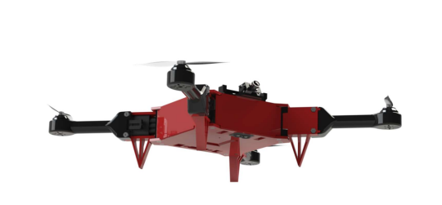
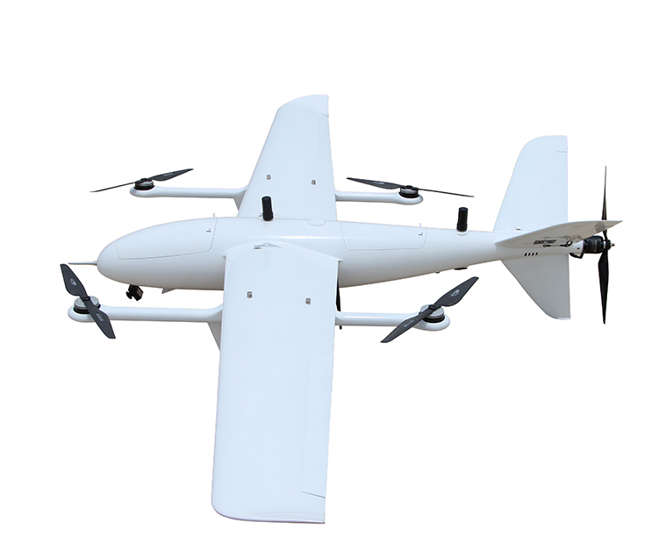
Background/Overview Slide
Every UAV, drone, or RC plane on the market is a single modality kit and constrained to a single flight pattern. Our project aims to expand the number of vehicle transportation modalities for the ModiFly Quadcopter through the addition of a VTOL Fixed-Wing module. This will allow for user to take the mainframe from the Modifly Quadcopter and attach the VTOL Fixed-Wing module without the need to purchase and build a whole entire kit. The VTOL-Fixed WIng module features are:
Longer flight duration
Reduced battery consumption
Vertical-Takeoff and Landing capability
Higher forward propulsion
Increase payload

Slide 3
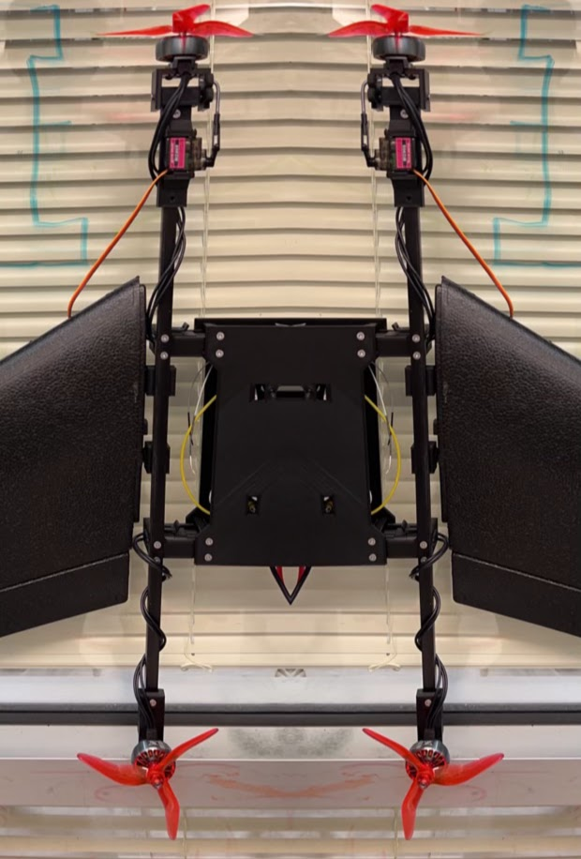
Tasks Completed
Cut and drilled carbon rod booms for wing to drone attachment.
Forward tilt and rear motor mounts designed and printed
Drone-to-carbon rod and wing-to-carbon rod attachments designed and printed

Slide 4
Current Problem or Obstacles Slide
Equal weight distribution over center of gravity of wings and forward flight.
Incorrect servo motor ordered.
Delayed servo motor and 7in propellers arrival.
Tilt-motor servo-arm rod transition is not as smooth as expected and could potentially cause issues.
Privately owned 3D printer needed maintenance and UTSA requested print request was unsuccessful due to geometry issues.

Slide 5
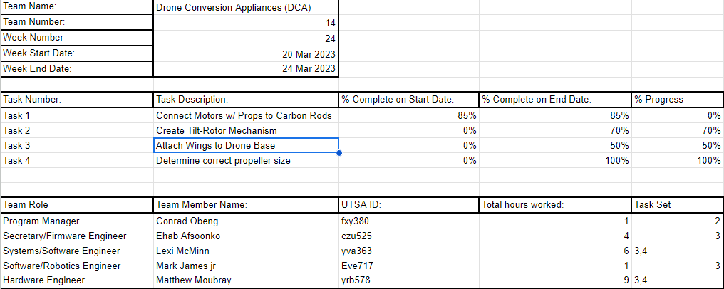
Week 24 Team Project Contribution Report

Slide 6
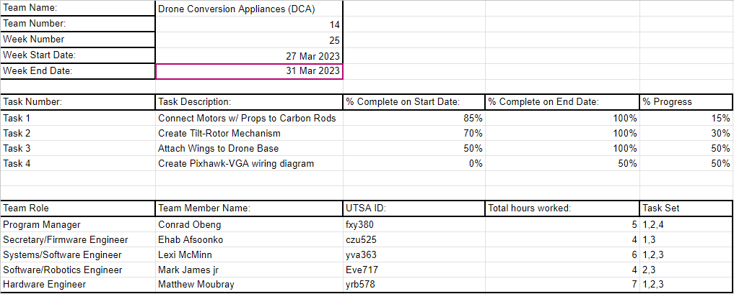
Week 25 Team Project Contribution Report

Slide 7
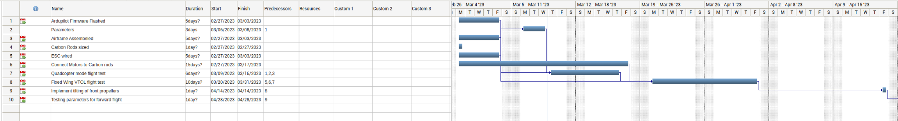
Work Breakdown Structure

Slide 8
Ongoing and Upcoming Tasks
Combination of plane and copter ardupilot firmware, which includes the tilt motor operation and lack of tail rudder servo motor.
Tilt motor rods
Pixhawk to VGA adapter wiring diagram.
Pixhawk to LiDAR installation.
Print spacers to increase ModiFly base height to accommodate battery height.
VTOL with wings takeoff test flight

Slide 9
Budget Slide
Item | Description | Cost
Pixhawk 2.4.8 | Flight Controller | $150
iFlight Xing-E Pro 2207(4pcs) | VTOL Motor | ~$66
HAKRC 45A 2-6S BLHeli_S 4in1 ESC | Motor ESC | $46
Turnigy Aerodrive SK3 | Forward Propeller Motor | ~$43.99
10x10x1000mm Carbon Fiber Rod | Carbon rods | $40

Slide 10
Budget Slide Con’t
Item | Description | Cost
Micro Metal Gear Digital Servo Motor x4 | Servo Motors | $15
4S LiPo Battery | Drone Battery | ~$70
3x8mm Screws x2 | Pivot Screws | $8
3mm Bolts x4 | Motor Bolts | $4
3x45mm Bolts x4 | Wing Mount Bolts | $7
3x20mm Bolts x4 | Tilt Mount Bolts | $6
3mm Washers x8 | Washers | $4
 | Total Cost | 459.99

Slide 11





Biographies Slide
Ehab Afsnooko - Firmware Engineer - C++, Python, Verilog, embedded systems
Conrad Obeng - Engineering Manager - Python,Drone Engineering,Drone Firmware
Lexi McMinn - Systems/Software Engineer - C++,Python,Verilog,VHDL
Mark James Jr. - Software/Robotics Engineer- Python,C++,Java
Matthew Moubray - Hardware Engineer - C++, Python, LabView, eCalc, Solidworks

Slide 12
Questions?

